Slide 1
FLIPKART REVIEWS SENTIMENTAL ANALYSIS
PRESENTED BY:
K.KEERTHANA
513121104015
THANTHAI PERIYAR GOVERNMENT INSTITUTE OF TECHNOLOGY VELLORE

Slide 2
FLIPKART REVIEWS SENTIMENTAL ANALYSIS
Project Title

Slide 3


AGENDA
Problem Statement
Project overview
End Users
Solution and its proposition
The WOW in the solution
Modeling
Results
Conclusion
3/21/2024 Annual Review

Slide 4

PROBLEM STATEMENT
Develop a sentiment analysis solution for Flipkart reviews. Analyze text data, visualize sentiment distribution, and train a model to classify reviews as positive or negative. Evaluate model performance and provide insights for understanding customer sentiment and enhancing product offerings.

Slide 5

PROJECT OVERVIEW
This project focuses on sentiment analysis of Flipkart reviews.
It involves collecting review data, preprocessing text, visualizing sentiment distribution, and training a model to classify reviews as positive or negative.
The aim is to provide insights into customer sentiment for product enhancement and decision-making.

Slide 6

WHO ARE THE END USERS?
Flipkart Product Managers
Customer Service Teams
Marketing Teams
Data Analysts
Consumers
3/21/2024 Annual Review

Slide 7

THE SOLUTION AND ITS VALUE PROPOSITION
By leveraging state-of-the-art natural language processing techniques, our solution preprocesses review text, visualizes sentiment distribution, and trains a robust classification model.
This enables stakeholders to effectively gauge customer sentiment, prioritize improvements, and enhance overall product offerings.
With real-time monitoring capabilities and customizable reporting, our proposition empowers decision-makers to make data-driven choices, improving customer satisfaction and business performance.

Slide 8

THE WOW IN SOLUTION
Real-time Insights
Comprehensive Analysis
Customizable Reporting
Predictive Capabilities
Integration Potential
3/21/2024 Annual Review
8

Slide 9
MODELLING
1.Data Preprocessing:
The modeling process begins with data preprocessing, where the raw text data from Flipkart reviews is cleaned and transformed into a format suitable for modeling. This typically involves steps such as removing punctuation, converting text to lowercase, and removing stopwords.
2.Feature Extraction:
Next, features are extracted from the preprocessed text data. In this project, TF-IDF (Term Frequency-Inverse Document Frequency) vectorization is used to convert the text data into numerical features. TF-IDF assigns weights to words based on their frequency in the document and across the entire corpus, capturing the importance of each word in distinguishing between positive and negative reviews.
3.Model Selection:
Once the features are extracted, a machine learning model is selected for sentiment classification. In this project, a Decision Tree classifier is chosen as the model. Decision Trees are simple yet powerful models that can capture complex relationships in the data and are well-suited for text classification tasks.
9

Slide 10
4.Model Training:
The selected model is trained on a portion of the preprocessed and feature-extracted data. During training, the model learns to map the input features (TF-IDF vectors) to the corresponding sentiment labels (positive or negative) based on the provided training data.
5.Model Evaluation:
After training, the performance of the trained model is evaluated using a separate portion of the data reserved for testing. Common evaluation metrics such as accuracy, precision, recall, and F1-score are calculated to assess how well the model generalizes to unseen data and its ability to correctly classify reviews into their respective sentiment categories.
6.Model Tuning and Optimization:
Depending on the evaluation results, the model may undergo tuning and optimization to improve its performance. This may involve adjusting hyperparameters, exploring different feature engineering techniques, or trying alternative algorithms.
7.Final Model Deployment:
Once a satisfactory level of performance is achieved, the final trained model is deployed for use in sentiment analysis tasks. This could involve integrating the model into a production environment where it can automatically classify incoming reviews in real-time or batch processing mode.

Slide 11
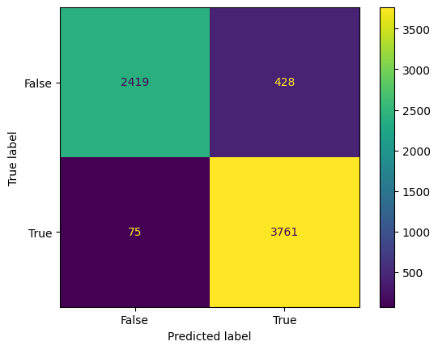
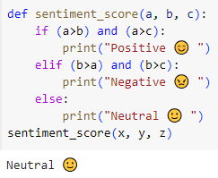
RESULTS
11

Slide 12
CONCLUSION
So, most people give Neutral reviews, and a small proportion of people give Negative reviews. So we can say that people are satisfied with Flipkart products and services.
In conclusion, this project presents a comprehensive solution for sentiment analysis of Flipkart reviews.
By leveraging advanced natural language processing techniques and machine learning algorithms, we have developed a robust framework to analyze customer sentiment, classify reviews as positive or negative, and provide actionable insights for stakeholders.

Slide 13
THANK YOU

